Slide 1
FAKULTAS TEKNOLOGI INFORMASI
PENAMBANGAN DATA
[ KP368 / 3 SKS ]

Slide 2
DATA PRE-PROCESSING - LanJUTAN
Pertemuan 4

Slide 3
Tujuan Pembelajaran
Mahasiswa mampu memahami berbagai bentuk data dan proses mempersiapkan data (data preprocessing)

Slide 4
Topik Pembahasan
3.1 Data
3.2 Data Preprocessing
3.3 Data Cleaning
3.4 Data Reduction
3.5 Data Transformation and Data Discretization
3.6 Data Integration

Slide 5
3.4 Data Reduction

Slide 6
Data Reduction Strategies
Data Reduction
Obtain a reduced representation of the data set that is much smaller in volume but yet produces the same analytical results
Why Data Reduction?
A database/data warehouse may store terabytes of data
Complex data analysis take a very long time to run on the complete dataset
Data Reduction Strategies
Dimensionality reduction
Feature Extraction
Feature Selection
Numerosity reduction (Data Reduction)
Regression and Log-Linear Models
Histograms, clustering, sampling

Slide 7
1. Dimensionality Reduction
Curse of dimensionality
When dimensionality increases, data becomes increasingly sparse
Density and distance between points, which is critical to clustering, outlier analysis, becomes less meaningful
The possible combinations of subspaces will grow exponentially
Dimensionality reduction
Avoid the curse of dimensionality
Help eliminate irrelevant features and reduce noise
Reduce time and space required in data mining
Allow easier visualization
Dimensionality reduction techniques
Feature Extraction: Wavelet transforms, Principal Component Analysis (PCA)
Feature Selection: Filter, Wrapper, Embedded

Slide 8
Principal Component Analysis (Steps)
Given N data vectors from n-dimensions, find k ≤ n orthogonal vectors (principal components) that can be best used to represent data
Normalize input data: Each attribute falls within the same range
Compute k orthonormal (unit) vectors, i.e., principal components
Each input data (vector) is a linear combination of the k principal component vectors
The principal components are sorted in order of decreasing “significance” or strength
Since the components are sorted, the size of the data can be reduced by eliminating the weak components, i.e., those with low variance
Works for numeric data only

Slide 9
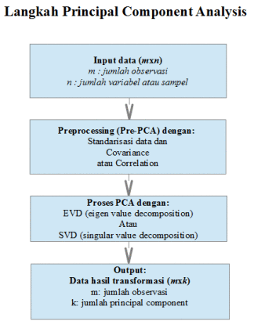
Principal Componen Analysis

Slide 10
Feature/Attribute Selection
Another way to reduce dimensionality of data
Redundant attributes
Duplicate much or all of the information contained in one or more other attributes
E.g., purchase price of a product and the amount of sales tax paid
Irrelevant attributes
Contain no information that is useful for the data mining task at hand
E.g., students' ID is often irrelevant to the task of predicting students' GPA

Slide 11
Feature Selection Approach
A number of proposed approaches for feature selection can broadly be categorized into the following three classifications: wrapper, filter, and hybrid (Liu & Tu, 2004)
In the filter approach, statistical analysis of the feature set is required, without utilizing any learning model (Dash & Liu, 1997)
In the wrapper approach, a predetermined learning model is assumed, wherein features are selected that justify the learning performance of the particular learning model (Guyon & Elisseeff, 2003)
The hybrid approach attempts to utilize the complementary strengths of the wrapper and filter approaches (Huang, Cai, & Xu, 2007)

Slide 12
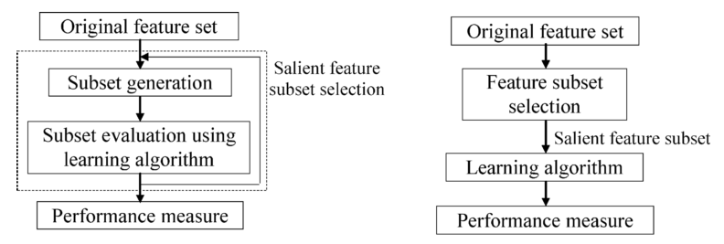
Wrapper Approach vs Filter Approach

Slide 13
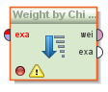
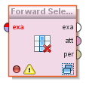
Feature Selection Approach
Filter Approach:
information gain
chi square
log likehood ratio
Wrapper Approach:
forward selection
backward elimination
randomized hill climbing
Embedded Approach:
decision tree
weighted naïve bayes

Slide 14
2. Numerosity Reduction
Reduce data volume by choosing alternative, smaller forms of data representation
Parametric methods (e.g., regression)
Assume the data fits some model, estimate model parameters, store only the parameters, and discard the data (except possible outliers)
Ex.: Log-linear models—obtain value at a point in m-D space as the product on appropriate marginal subspaces
Non-parametric methods
Do not assume models
Major families: histograms, clustering, sampling, …

Slide 15
Parametric Data Reduction: Regression and Log-Linear Models
Linear regression
Data modeled to fit a straight line
Often uses the least-square method to fit the line
Multiple regression
Allows a response variable Y to be modeled as a linear function of multidimensional feature vector
Log-linear model
Approximates discrete multidimensional probability distributions

Slide 16
Regression Analysis
Regression analysis: A collective name for techniques for the modeling and analysis of numerical data consisting of values of a dependent variable (also called response variable or measurement) and of one or more independent variables (aka. explanatory variables or predictors)
The parameters are estimated so as to give a "best fit" of the data
Most commonly the best fit is evaluated by using the least squares method, but other criteria have also been used
Used for prediction (including forecasting of time-series data), inference, hypothesis testing, and modeling of causal relationships
Y1
Y1’
y = x + 1
X1
x

Slide 17
Regress Analysis and Log-Linear Models
Linear regression: Y = w X + b
Two regression coefficients, w and b, specify the line and are to be estimated by using the data at hand
Using the least squares criterion to the known values of Y₁, Y₂, …, X₁, X₂, ….
Multiple regression: Y = b₀ + b₁ X₁ + b₂ X₂
Many nonlinear functions can be transformed into the above
Log-linear models:
Approximate discrete multidimensional probability distributions
Estimate the probability of each point (tuple) in a multi-dimensional space for a set of discretized attributes, based on a smaller subset of dimensional combinations
Useful for dimensionality reduction and data smoothing

Slide 18
Histogram Analysis
Divide data into buckets and store average (sum) for each bucket
Partitioning rules:
Equal-width: equal bucket range
Equal-frequency (or equal-depth)

Slide 19
Clustering
Partition data set into clusters based on similarity, and store cluster representation (e.g., centroid and diameter) only
Can be very effective if data is clustered but not if data is “smeared”
Can have hierarchical clustering and be stored in multi-dimensional index tree structures
There are many choices of clustering definitions and clustering algorithms

Slide 20
Sampling
Sampling: obtaining a small sample s to represent the whole data set N
Allow a mining algorithm to run in complexity that is potentially sub-linear to the size of the data
Key principle: Choose a representative subset of the data
Simple random sampling may have very poor performance in the presence of skew
Develop adaptive sampling methods, e.g., stratified sampling
Note: Sampling may not reduce database I/Os (page at a time)

Slide 21
Types of Sampling
Simple random sampling
There is an equal probability of selecting any particular item
Sampling without replacement
Once an object is selected, it is removed from the population
Sampling with replacement
A selected object is not removed from the population
Stratified sampling
Partition the data set, and draw samples from each partition (proportionally, i.e., approximately the same percentage of the data)
Used in conjunction with skewed data

Slide 22
Sampling: With or without Replacement
SRSWOR
(simple random
sample without
replacement)
SRSWR
Raw Data

Slide 23
Sampling: Cluster or Stratified Sampling
Raw Data
Cluster/Stratified Sample

Slide 24
Stratified Sampling
Stratification is the process of dividing members of the population into homogeneous subgroups before sampling
Suppose that in a company there are the following staff:
Male, full-time: 90
Male, part-time: 18
Female, full-time: 9
Female, part-time: 63
Total: 180
We are asked to take a sample of 40 staff, stratified according to the above categories
An easy way to calculate the percentage is to multiply each group size by the sample size and divide by the total population:
Male, full-time = 90 × (40 ÷ 180) = 20
Male, part-time = 18 × (40 ÷ 180) = 4
Female, full-time = 9 × (40 ÷ 180) = 2
Female, part-time = 63 × (40 ÷ 180) = 14

Slide 25
3.5 Data Transformation and Data Discretization

Slide 26
Data Transformation
A function that maps the entire set of values of a given attribute to a new set of replacement values
Each old value can be identified with one of the new values
Methods:
Smoothing: Remove noise from data
Attribute/feature construction
New attributes constructed from the given ones
Aggregation: Summarization, data cube construction
Normalization: Scaled to fall within a smaller, specified range
min-max normalization
z-score normalization
normalization by decimal scaling
Discretization: Concept hierarchy climbing

Slide 27
Normalization
Min-max normalization: to [new_min_{A}, new_max_{A}]
Ex. Let income range $12,000 to $98,000 normalized to [0.0, 1.0]. Then $73,000 is mapped to
Z-score normalization (μ: mean, σ: standard deviation):
Ex. Let μ = 54,000, σ = 16,000. Then
Normalization by decimal scaling
Where j is the smallest integer such that Max(|ν’|) < 1

Slide 28
Discretization
Three types of attributes
Nominal —values from an unordered set, e.g., color, profession
Ordinal —values from an ordered set, e.g., military or academic rank
Numeric —real numbers, e.g., integer or real numbers
Discretization: Divide the range of a continuous attribute into intervals
Interval labels can then be used to replace actual data values
Reduce data size by discretization
Supervised vs. unsupervised
Split (top-down) vs. merge (bottom-up)
Discretization can be performed recursively on an attribute
Prepare for further analysis, e.g., classification

Slide 29
Data Discretization Methods
Typical methods: All the methods can be applied recursively
Binning: Top-down split, unsupervised
Histogram analysis: Top-down split, unsupervised
Clustering analysis: Unsupervised, top-down split or bottom-up merge
Decision-tree analysis: Supervised, top-down split
Correlation (e.g., χ²) analysis: Unsupervised, bottom-up merge

Slide 30
Simple Discretization: Binning
Equal-width (distance) partitioning
Divides the range into N intervals of equal size: uniform grid
if A and B are the lowest and highest values of the attribute, the width of intervals will be: W = (B –A)/N.
The most straightforward, but outliers may dominate presentation
Skewed data is not handled well
Equal-depth (frequency) partitioning
Divides the range into N intervals, each containing approximately same number of samples
Good data scaling
Managing categorical attributes can be tricky

Slide 31
Binning Methods for Data Smoothing
Sorted data for price (in dollars): 4, 8, 9, 15, 21, 21, 24, 25, 26, 28, 29, 34
Partition into equal-frequency (equi-depth) bins:
Bin 1: 4, 8, 9, 15
Bin 2: 21, 21, 24, 25
Bin 3: 26, 28, 29, 34
Smoothing by bin means:
Bin 1: 9, 9, 9, 9
Bin 2: 23, 23, 23, 23
Bin 3: 29, 29, 29, 29
Smoothing by bin boundaries:
Bin 1: 4, 4, 4, 15
Bin 2: 21, 21, 25, 25
Bin 3: 26, 26, 26, 34

Slide 32
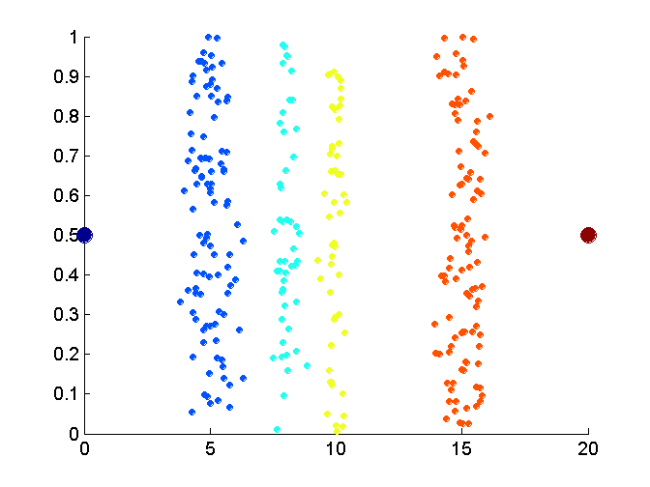
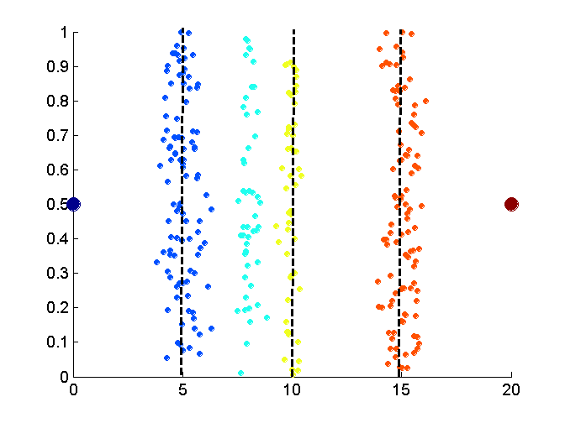
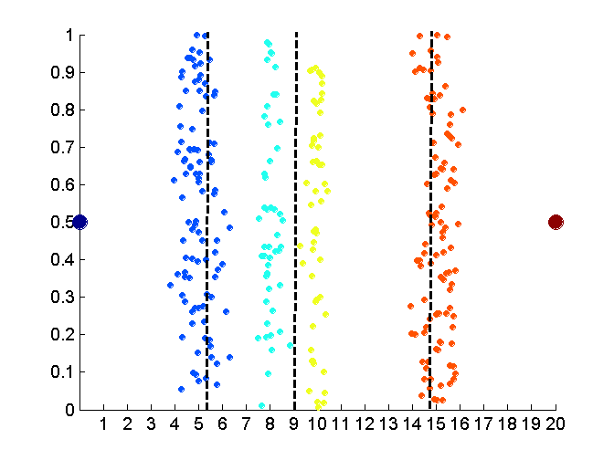
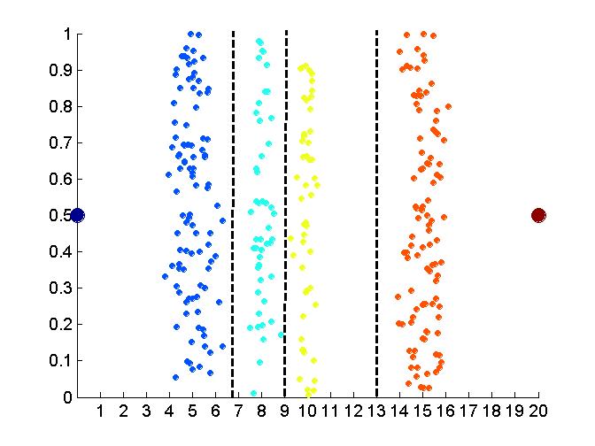
Discretization Without Using Class Labels (Binning vs. Clustering)
Data
Equal interval width (binning)
Equal frequency (binning)
K-means clustering leads to better results

Slide 33
Discretization by Classification & Correlation Analysis
Classification (e.g., decision tree analysis)
Supervised: Given class labels, e.g., cancerous vs. benign
Using entropy to determine split point (discretization point)
Top-down, recursive split
Correlation analysis (e.g., Chi-merge: χ²-based discretization)
Supervised: use class information
Bottom-up merge: find the best neighboring intervals (those having similar distributions of classes, i.e., low χ² values) to merge
Merge performed recursively, until a predefined stopping condition

Slide 34
3.6 Data Integration

Slide 35
Data Integration
Data integration:
Combines data from multiple sources into a coherent store
Schema Integration: e.g., A.cust-id ≡ B.cust-#
Integrate metadata from different sources
Entity Identification Problem:
Identify real world entities from multiple data sources, e.g., Bill Clinton = William Clinton
Detecting and Resolving Data Value Conflicts
For the same real world entity, attribute values from different sources are different
Possible reasons: different representations, different scales, e.g., metric vs. British units

Slide 36
Handling Redundancy in Data Integration
Redundant data occur often when integration of multiple databases
Object identification: The same attribute or object may have different names in different databases
Derivable data: One attribute may be a “derived” attribute in another table, e.g., annual revenue
Redundant attributes may be able to be detected by correlation analysis and covariance analysis
Careful integration of the data from multiple sources may help reduce/avoid redundancies and inconsistencies and improve mining speed and quality

Slide 37
Referensi
Jiawei Han and Micheline Kamber, Data Mining: Concepts and Techniques Third Edition, Elsevier, 2012
Ian H. Witten, Frank Eibe, Mark A. Hall, Data mining: Practical Machine Learning Tools and Techniques 3rd Edition, Elsevier, 2011
Markus Hofmann and Ralf Klinkenberg, RapidMiner: Data Mining Use Cases and Business Analytics Applications, CRC Press Taylor & Francis Group, 2014
Daniel T. Larose, Discovering Knowledge in Data: an Introduction to Data Mining, John Wiley & Sons, 2005
Ethem Alpaydin, Introduction to Machine Learning, 3rd ed., MIT Press, 2014
Florin Gorunescu, Data Mining: Concepts, Models and Techniques, Springer, 2011
Oded Maimon and Lior Rokach, Data Mining and Knowledge Discovery Handbook Second Edition, Springer, 2010
Warren Liao and Evangelos Triantaphyllou (eds.), Recent Advances in Data Mining of Enterprise Data: Algorithms and Applications, World Scientific, 2007

Slide 38
Kesimpulan
Data reduction
Dimensionality reduction
Numerosity reduction
Data transformation and data discretization
Normalization
Data integration from multiple sources:
Entity identification problem
Remove redundancies
Detect inconsistencies

Slide 39


Kesimpulan
SELESAI

